Slide 1
M1

Slide 2
13. WHY DO WE FALL ILL

Slide 3

What is health ?

Slide 4
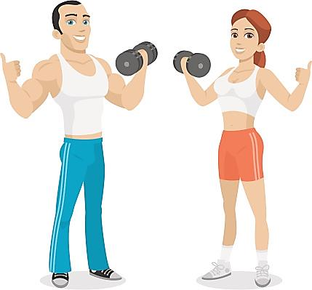
All of us like to remain fit and healthy.

Slide 5
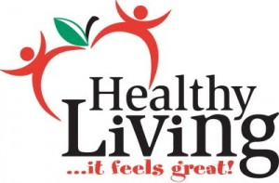
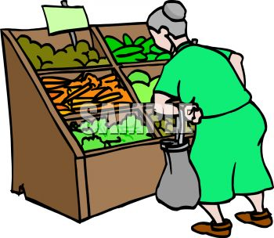
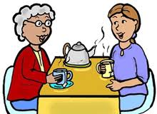

Words such as healthy habits, healthy food and healthy lifestyle or the proverb health is wealth are frequently heard around us.
When one says ‘My grand mother is old, her health is not good’, what does the word health imply?
For our grandmothers, being able to go out to the market or to visit neighbours is ‘being well’,
Many a times we think of health as physical well being of a person.
and not being able to do such things is ‘poor health’.

Slide 6

But does the word health have only physical aspect?
NO !!!

Slide 7

According to definition of World Health Organisation (WHO)
“Health is a state of complete physical, mental & social wellbeing and not just absence of disease.”

Slide 8
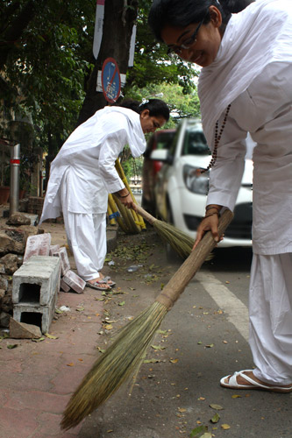
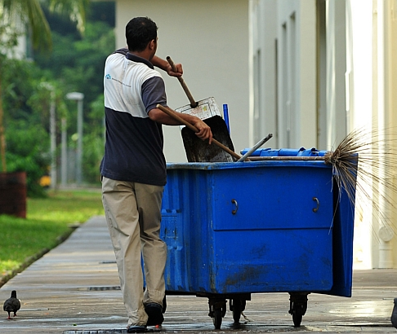
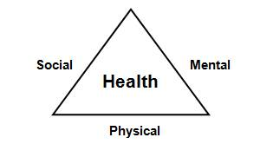
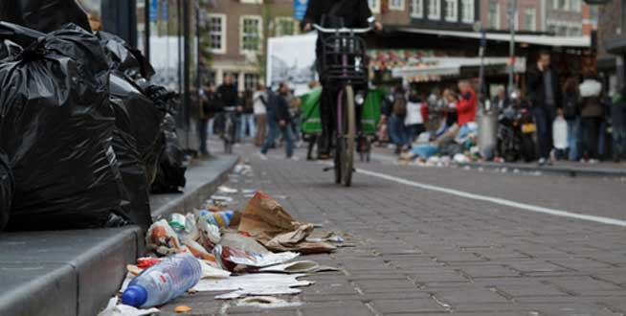
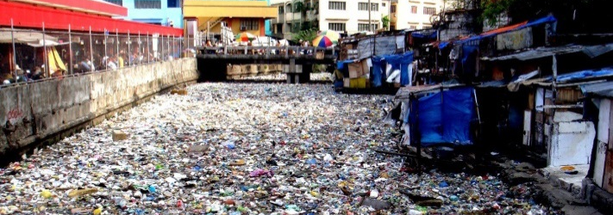
Personal and community issues
Both matter for health
If health means a state of physical, mental and social well-being, it cannot be something that each one of us can achieve entirely on our own.
The health of all organisms will depend on their surroundings or their environment.
So, if there is a great deal of garbage thrown in our streets,
Or if there is open drain-water lying stagnant around where we live, the possibility of poor health increases.
Therefore, public cleanliness is important for individual health.

Slide 9
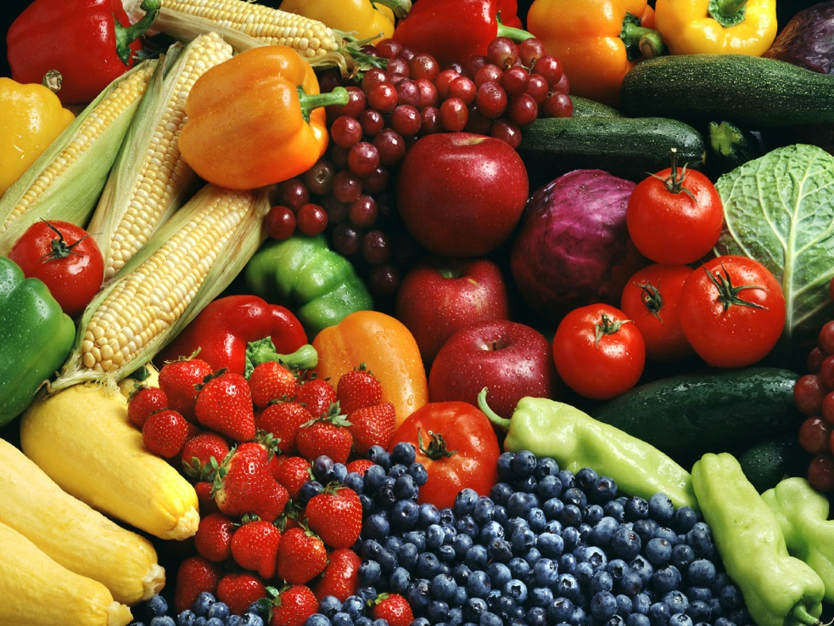

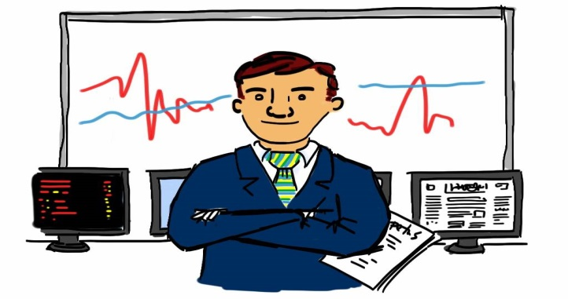
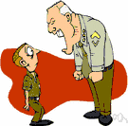
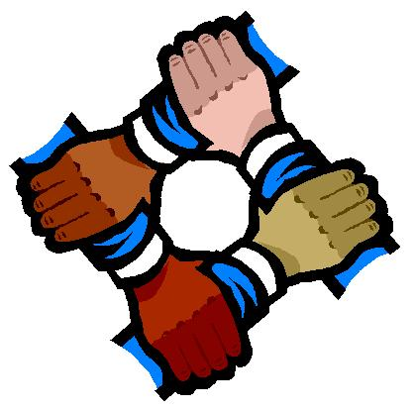
Personal and community issues
Both matter for health
We need food for health, and this food will have to be earned by doing work.
For this, the opportunity to do work has to be available.
Good economic conditions and jobs are therefore needed for individual health.
We need to be happy in order to be truly healthy, and if we mistreat each other and are afraid of each other, we cannot be happy or healthy.
Social equality and harmony are therefore necessary for individual health.

